Slide 1
Studying beta-diversity: ecological variation partitioning
Wubing Xu
wubing.xu@idiv.de
Notes:
Metacommunity analysis: variation partitioning lecture and exercises
Variation in species composition: beta diversity
Measuring beta-diversity (pairwise, Multiplicative..)
Processes affecting beta-diversity (spatial - distance decay, niche selection)
Relative importance of process (examples, literatures)
Variation partition based on distance metrics
multiple linear regression, partial regression, mantel test
Variation partition using ordination methods
RDA, partial RDA, db-RDA, polynomials, PCNM, ordination plot

Slide 2
Differences in species compositions
S1
S2
Site A
S1
Different identities
S3
S2
S4
Site B
Different abundances of same identities
Site C
S2
S2
S2
S1
S1
S1
S3
S1
S1
S3
S3
Site D

Slide 3
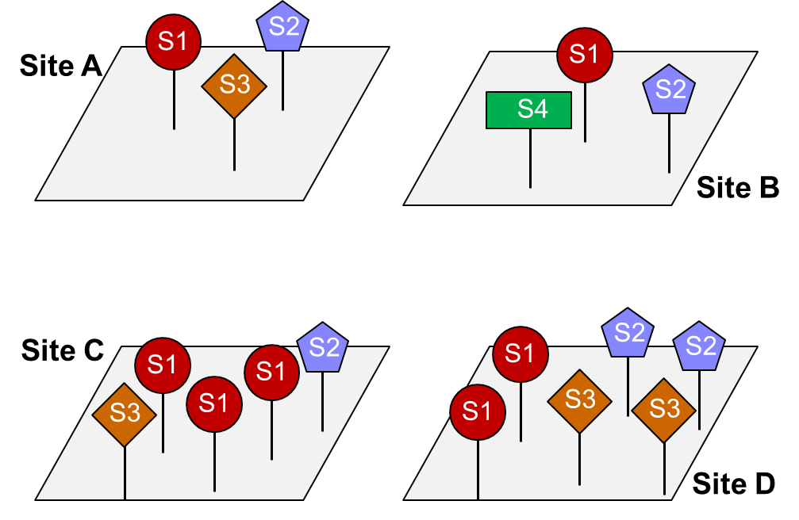
Different components of biodiversity
𝛾-diversity
𝛼-diversity
𝛽-diversity

Slide 4


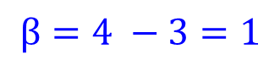
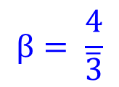
Measuring beta-diversity
Measured in a single number for each region
Multiplicative: $β= \frac{γ}{\overline{α}}$
$$β= \frac{4}{\overline{3}}$$
Additive: $β= γ −\overline{α}$
$$β=4 −3=1$$

Slide 5
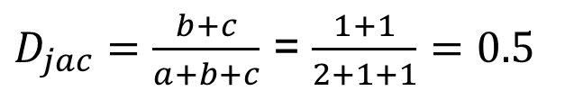
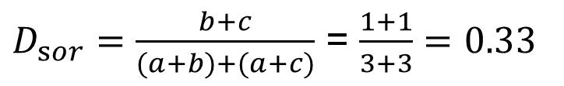
Measuring beta-diversity
Dissimilarity between two communities
Incidence-based
Jaccard
$D_{jac}=\frac{b+c}{a+b+c}$ = $\frac{1+1}{2+1+1}=0.5$
Sørensen
$D_{sor}=\frac{b+c}{(a+b)+(a+c)}$ = $\frac{1+1}{3+3}=0.33$
Site A
b
a
c
Site B

Slide 6
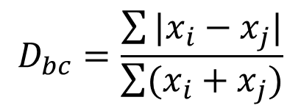
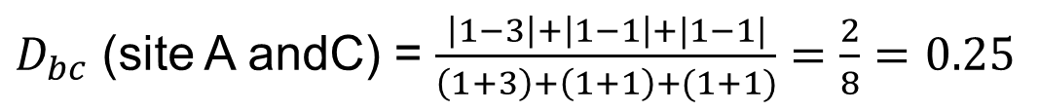
Measuring beta-diversity
Dissimilarity between two communities
Abundance-based
$$D_{bc}=\frac{\sum{|x_{i}−x_{j}|}}{\sum{(x_{i}+x_{j})}}$$
bray-curtis
$x_{i}$ and $x_{j}$: abudance of a species in site i and site j
$D_{bc}$ (site A andC) = $\frac{\left|1−3\right|+\left|1−1\right|+|1−1|}{\left(1+3\right)+\left(1+1\right)+(1+1)}=\frac{2}{8}=0.25$
Many other beta diversity indices are reviewed in Koleff et al. (2003), Anderson et al. (2011), Jost (2007) and other papers.

Slide 7
Why species compositions are different?
Niche-based perspective
- different preference of environmental conditions
Abundance
Environmental gradient

Slide 8
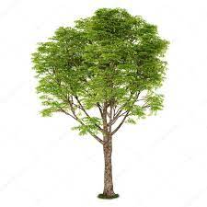
Why species compositions are different?
Spatial based perspective (neutral): dispersal limitation, etc.
Distance decay of similarity between communities
Seed shade
Similarity
Spatial distance

Slide 9
Which processes are more important: space vs. environment
Neutral Model
Niche Model
Beta-diversity
Beta-diversity
Spatial distance
Spatial distance
Environmental distance
Environmental distance
Chase et al. 2005

Slide 10
Variation partitioning of the effects of space & environment
Space
Environment
[a]: pure spatial effects
[c]: pure environmental effects
[b]: Spatially structured environmental effects
[d]: residual variance
a
b
c
Residuals = d

Slide 11
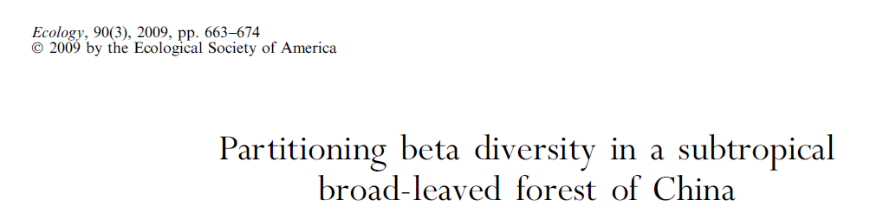
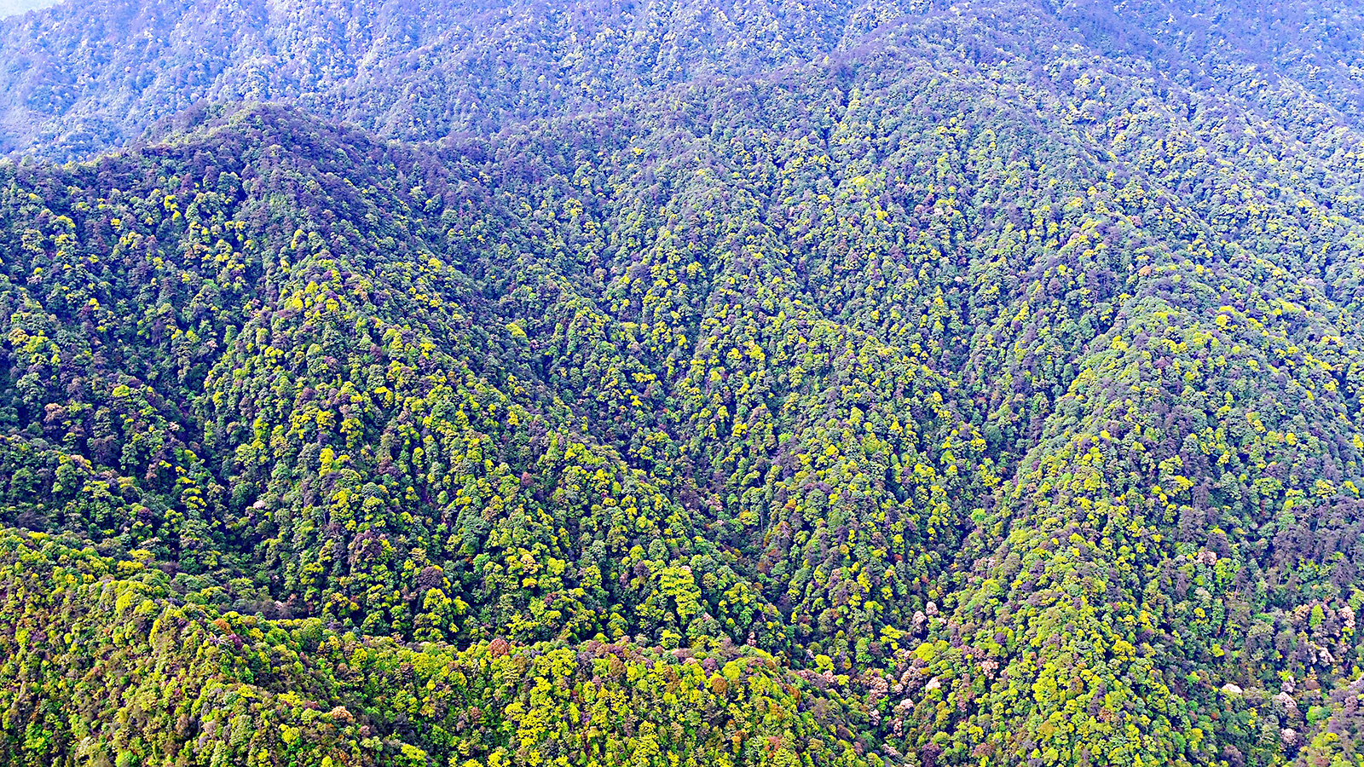
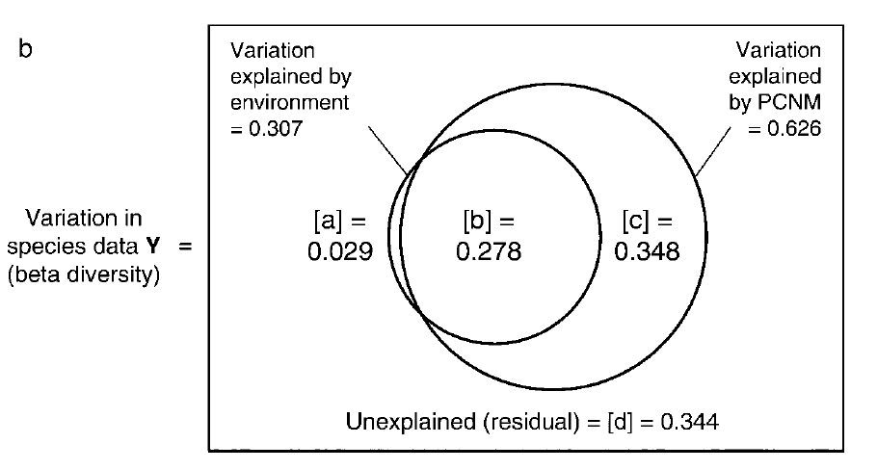
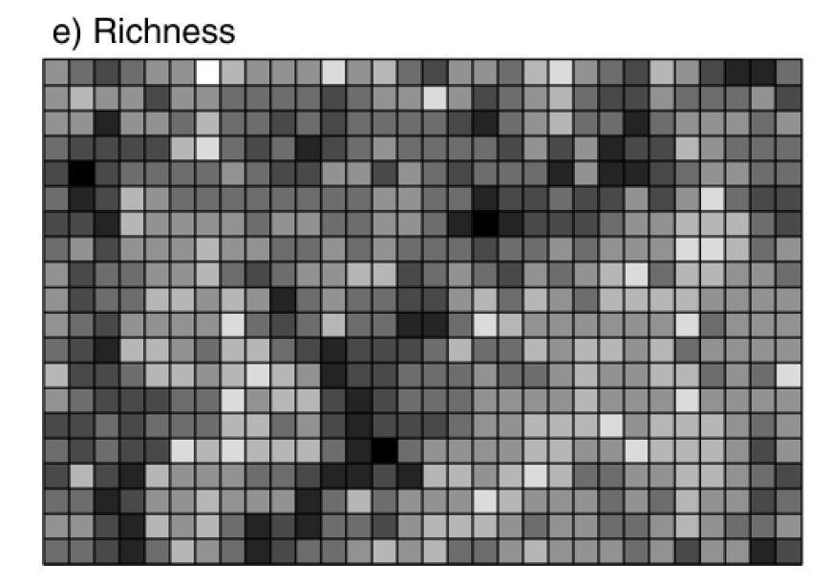
Variation in species compositions were mainly explained by spatially structured environmental effects (27.8%) and pure spatial effects (34.8%)

Slide 12
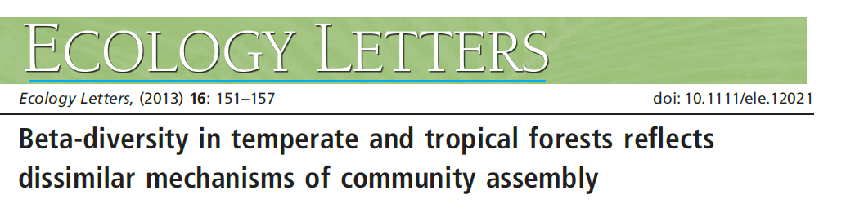
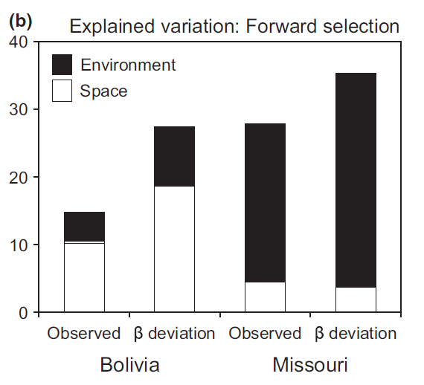
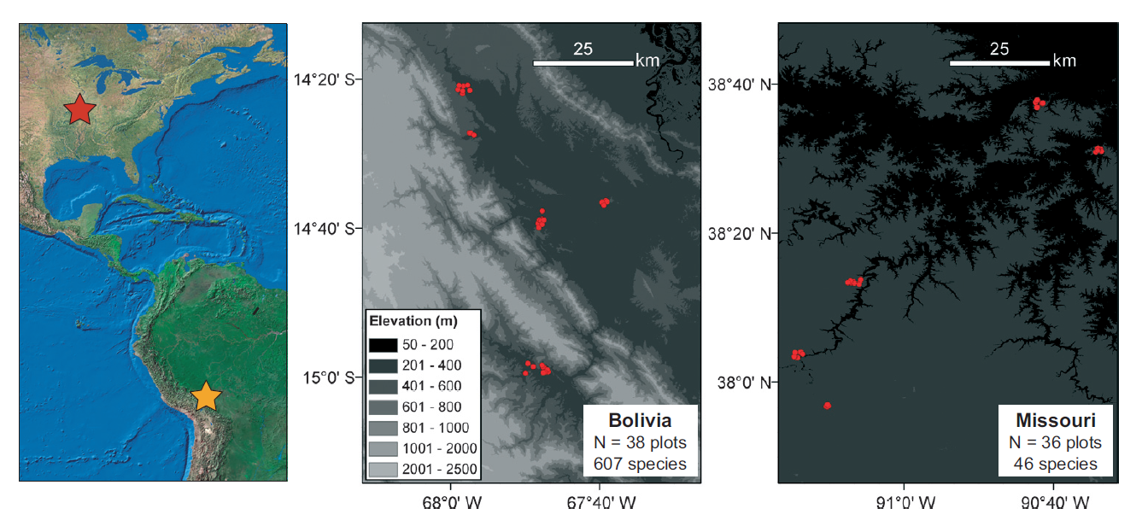
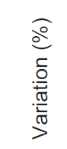
In temperate forest: stronger environmental effects (e.g. environmental filtering processes)
In tropical forest: stronger spatial effects (e.g. dispersal limitation)
Myers et al. 2013

Slide 13
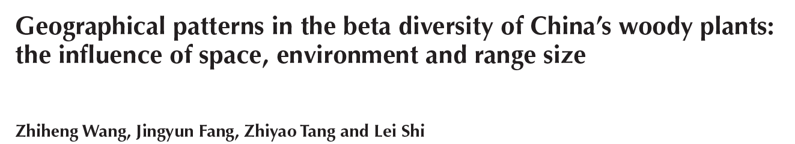
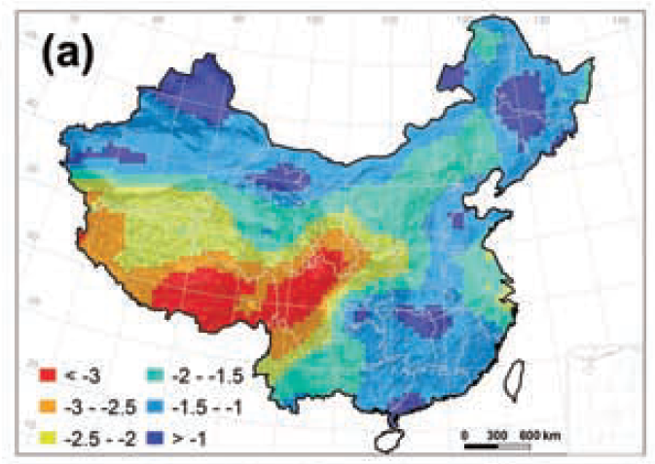
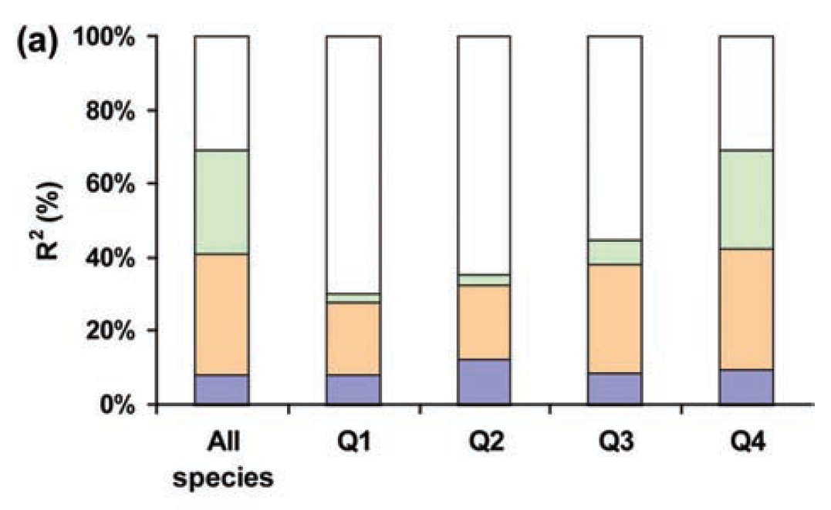
Environments explained more variation for large-ranged species
Fractions: pure spatial effects (blue), pure environmental effects (pink), spatially structured environmental effects (green)
Q1–Q4: species with small, medium, large and very large ranges

Slide 14
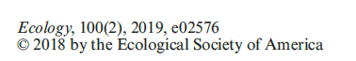
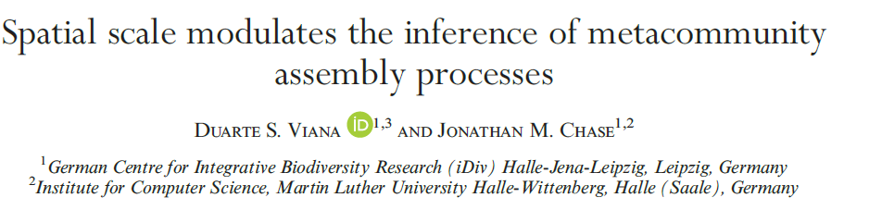
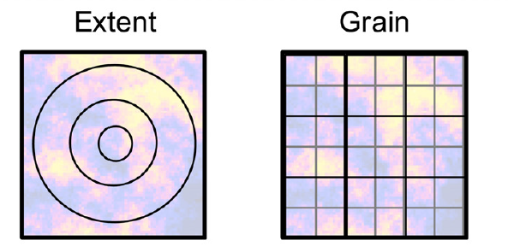
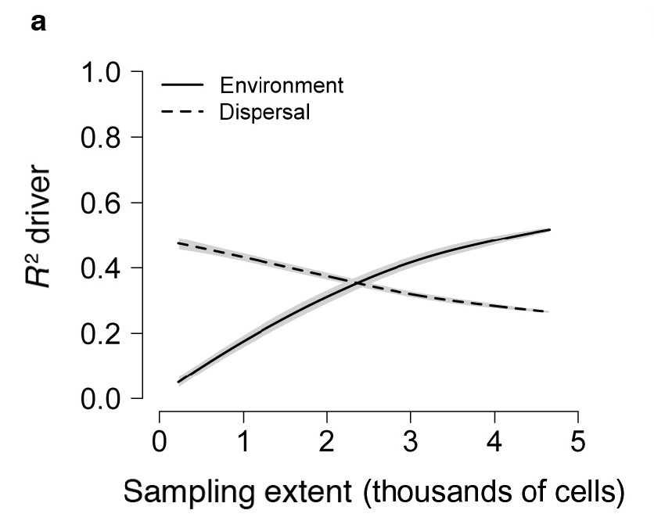
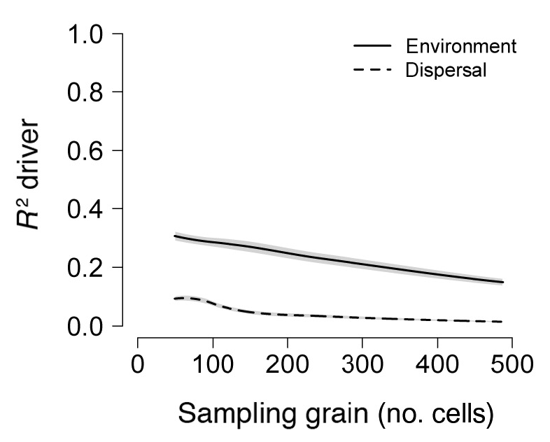

Slide 15
Variation partitioning of β-diversity between sites
Environmental
Spatial
distance
Environmental distance
Spatial
a
b
c
beta-diversity
Residuals = d
Notes:
Venn diagram
Multiple linear regression, partial regression
Fit three model for variation partitioning
Mantel test

Slide 16
Multiple and partial linear regression
Multiple linear regression
y ~ S + E
- Combined effects of S and E on y
Partial linear regression
- computes a linear model of the relationship y ~ S while controlling for the effects of E
(y ~ S ) | E

Slide 17
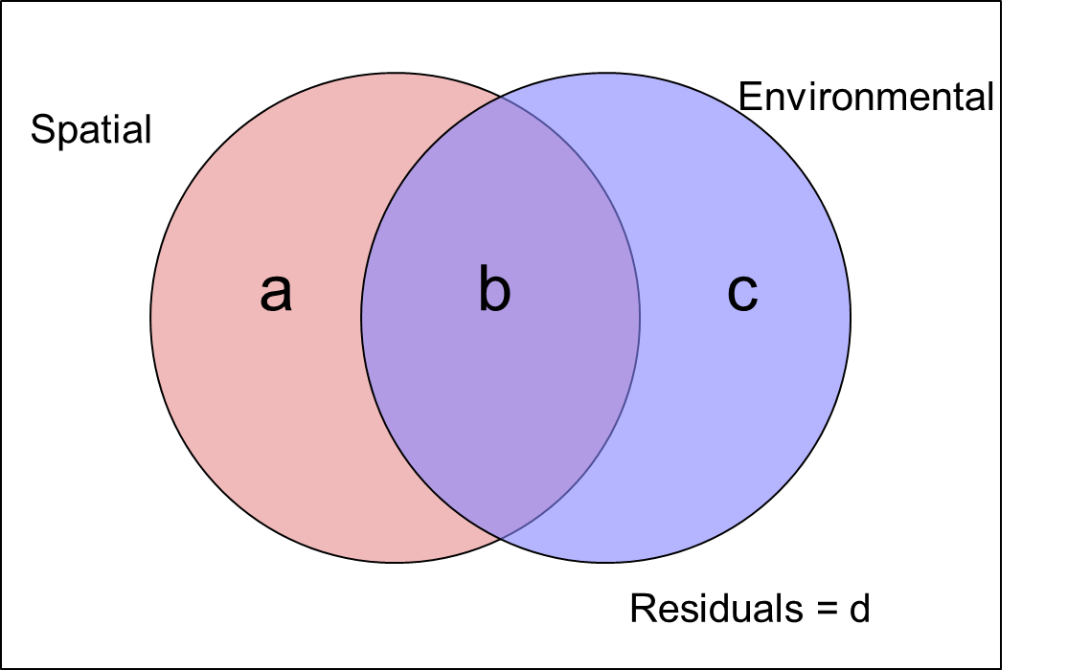
Compute the fractions of variation
The objective is to compute the values of fractions [a], [b] and [c]
lm(y ~ cbind(S, E)) => R2.adj = [a+b+c]
lm(y ~ S) => R2.adj = [a+b]
lm(y ~ E) => R2.adj = [b+c]
[a] = [a+b+c] – [b+c]
[c] = [a+b+c] – [a+b]
[b] = [a+b+c] – [a] – [c]
[d] = 1 + [a+b+c]
function ‘varpart’ in package ‘vegan’
y, S and E should be provided in vectors

Slide 18
Tests of significance of the fractions
y
~
S
+
E
Dissimilarity of
species composition
Spatial distance
Environmental distance
Each element is a pair of sites
1 2 3 … n
1 2 3 … n
1 2 3 … n
1 2 3
.
.
.
n
Comp. D
1 2 3
.
.
.
n
Spat. D
1 2 3
.
.
.
n
Env. D
Values are not independent
Unfold the D matrices
1
2
3
.
.
.
etc.
1
2
3
.
.
.
etc.
1
2
3
.
.
.
etc.

Slide 19
Mantel test
A method to test relationship between values in two dissimilarity (or distance) matrices
Permute rows and columns of a dissimilarity matrix N (e.g. 999) times
Calculate the correlations between the permuted matrices
Compare the observed and random correlations
y
~
S
1 2 3 … n
1 2 3 … n
1 2 3
.
.
.
n
Comp. D
1 2 3
.
.
.
n
Spat. D
Correlations between two matrices: function ‘mantel’ in R package ‘vegan’
Correlations between two matrices while controlling for a third matrix: function ‘mantel.partial’

Slide 20
Variation partitioning using multivariate regression
y
~
S
+
E
Multiple linear regression
1
.
.
.
etc.
1
.
.
.
etc.
1
.
.
.
etc.
Dissimilarity
Spatial distance
Environmental distance
Y
~
S
+
E
species y₁…y_{p}
variables s₁…s_{p}
variables e₁…e_{p}
Multivariate regression
Y
S
E
sites 1 to n
Species composition
sites 1 to n
space
sites 1 to n
environment
Notes:
Difference with partial regression
Ordination and RDA
Multiple linear regression and RDA
Data transformation and Multevariate regression
Variance
PCNM
Variation partitioning and test
Variable selection
PCA (2 slides)
RDA (how and plot, 2 page)

Slide 21
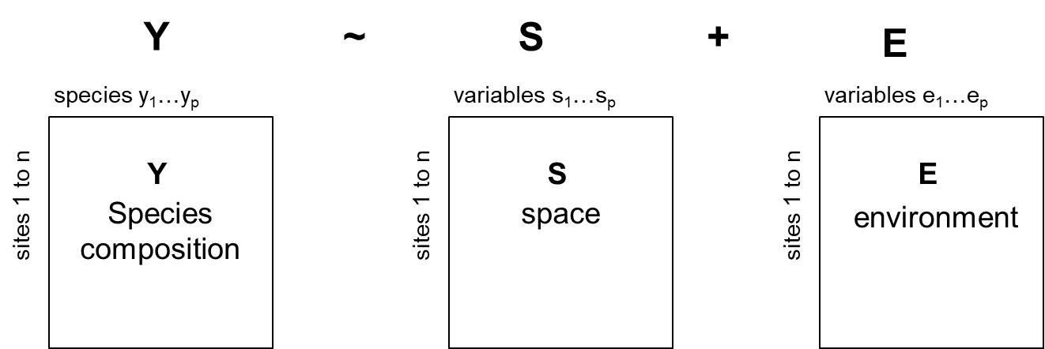
Redundancy analysis (RDA)
RDA is an method of canonical analysis
Canonical analysis allow ecologists to perform direct comparisons of two data matrices about the same objects (rows).
RDA can be used to test the relationship between a matrix Y describing species composition and a matrix E containing environmental variables
Partial RDA can controlling for the effects of a third matrix.

Slide 22
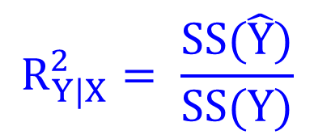

Multivariate regression in RDA
Response variables
Explanatory variables
Data table
Y
Data table
X
Proportion of variation explained:
(centered variables)
(centered variables)
$$R_{Y|X}^{2}= \frac{SS(\hat{Y})}{SS(Y)}$$
Regress each variable y on X and compute the fitted and residuals values
Fitted values from the multiple regressions
$$\hat{Y}$$

Slide 23
Species data transformation
Raw data
(sites×species)
Transformed data
(sites×species)
Input into PCA, RDA, etc.
Data transformation
Hellinger transformation
species y₁…y_{p}
Divide by row sums (total abundance)
Calculate square root
Y
sites 1 to n
Species composition
Use vegan’s decostand() function
Y.tr = decostand(Y, "hellinger")
Notes:
The profile, chord, log-chord, Hellinger and chi-square transf. can be computed using vegan’s decostand() function.
Hellinger transformation: Y.tr = decostand(Y, "hellinger")

Slide 24
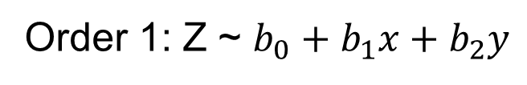
How to consider space in variation partitioning
Use the spatial coordinates of sites
Order 1: Z ~ $b_{0}+b_{1}x+b_{2}y$
Order 2: Z ~ $b_{0}+b_{1}x+b_{2}y$ $+b_{3}x^{2}+b_{4}xy$ $+b_{5}y^{2}$
Order 3: Z ~ $b_{0}+b_{1}x+b_{2}y$ $+b_{3}x^{2}+b_{4}xy$ $+b_{5}y^{2}$ $+b_{6}y^{3}$ $+b_{7}x^{2}y$ $+b_{8}xy^{2}$ $+b_{9}y^{3}$
PCNM (principal coordinates of neighbor matrices)
- It can model spatial structures at all scales
- Based on a truncated distance matrix between sites
Notes:
polynomial regression

Slide 25
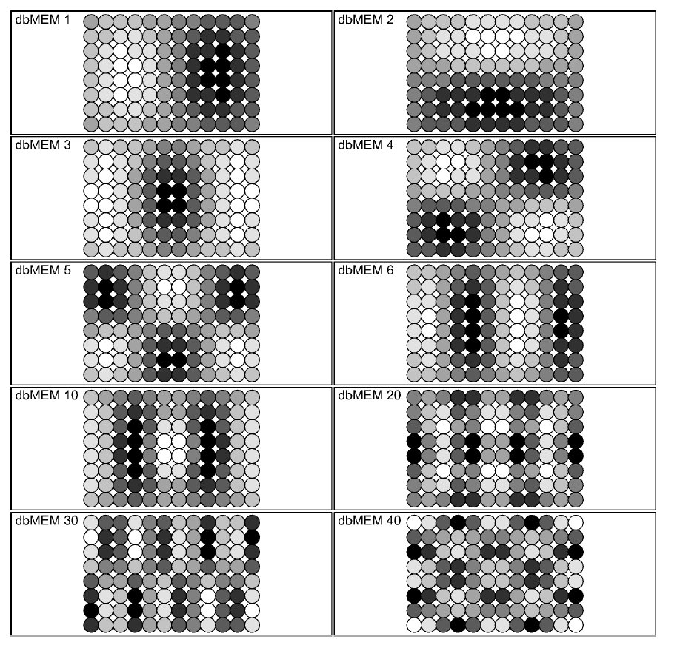
Ten of the 48 dbMEM (PCNM) spatial eigenfunctions that model positive spatial correlation on a regular grid with 12 x 8 pixesl (sites, quadrats).
Empty bubbles = positive values, black = negative values (or the opposite, your choice).
From the Legendre slides

Slide 26
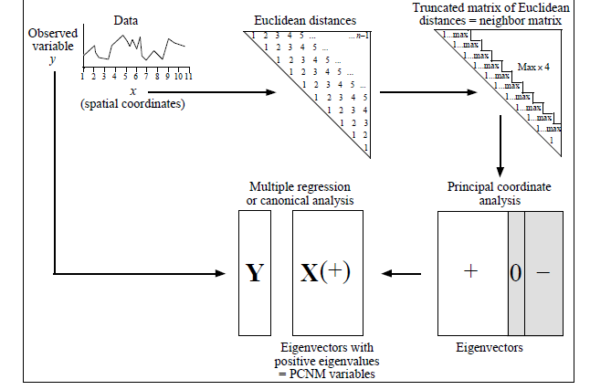
PCNM: principal coordinates of neighbour matrices
Use function ‘pcnm’ (vegan)
or function ‘PCNM’ (PCNM)

Slide 27
Compute the fractions of variation
Use the RDA to calculate fractions
rda(Y, cbind(S, E)) => R2.adj = [a+b+c]
rda(Y, S) => R2.adj = [a+b]
rda(Y, E) => R2.adj = [b+c]
[a] = [a+b+c] – [b+c]
[c] = [a+b+c] – [a+b]
[b] = [a+b+c] – [a] – [c]
[d] = 1 + [a+b+c]
function ‘varpart’ in package ‘vegan’
Y – species composition (sites×species)
S – PCNM variables (sites×variables)
E - Environmental variables (sites×variables)

Slide 28
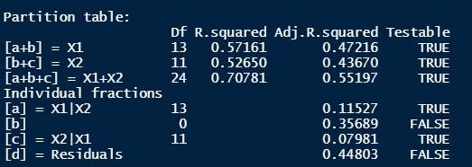
Tests of significance of the fractions
Results returned by function rda()
Function ‘anova.cca’ in package ‘vegan’
Test [a+b] : anova.cca(rda(Y, S))
Test [a] : anova.cca(rda(Y, S, E) )

Slide 29
Selection of explanatory variables
Many explanatory variables in some empirical studies
Select variables to fit a small model
Selection methods –
Forward selection: enter variables one at a time ("forward")
Backward elimination: eliminate var. one at a time ("backward")
Functions ordistep() and ordiR2step() in vegan

Slide 30
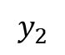
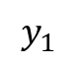
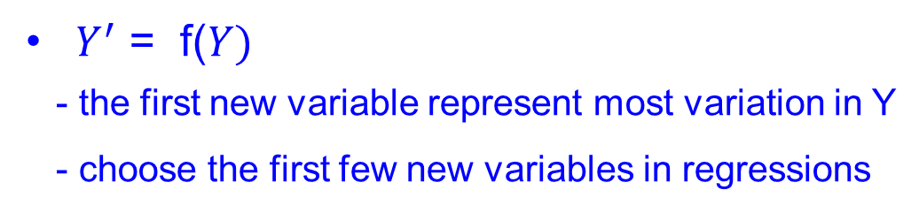
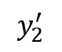
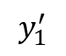
PCA: Principal component analysis
Use PCA to generate fewer axis (new variables) representing most variation in raw variables (e.g environmental variable)
$$y_{2}$$
$Y^{′}$ = f($Y)$
- the first new variable represent most variation in Y
- choose the first few new variables in regressions
$$y_{2}^{′}$$
$$y_{1}^{′}$$
function princomp() in vegan
$$y_{1}$$

Slide 31
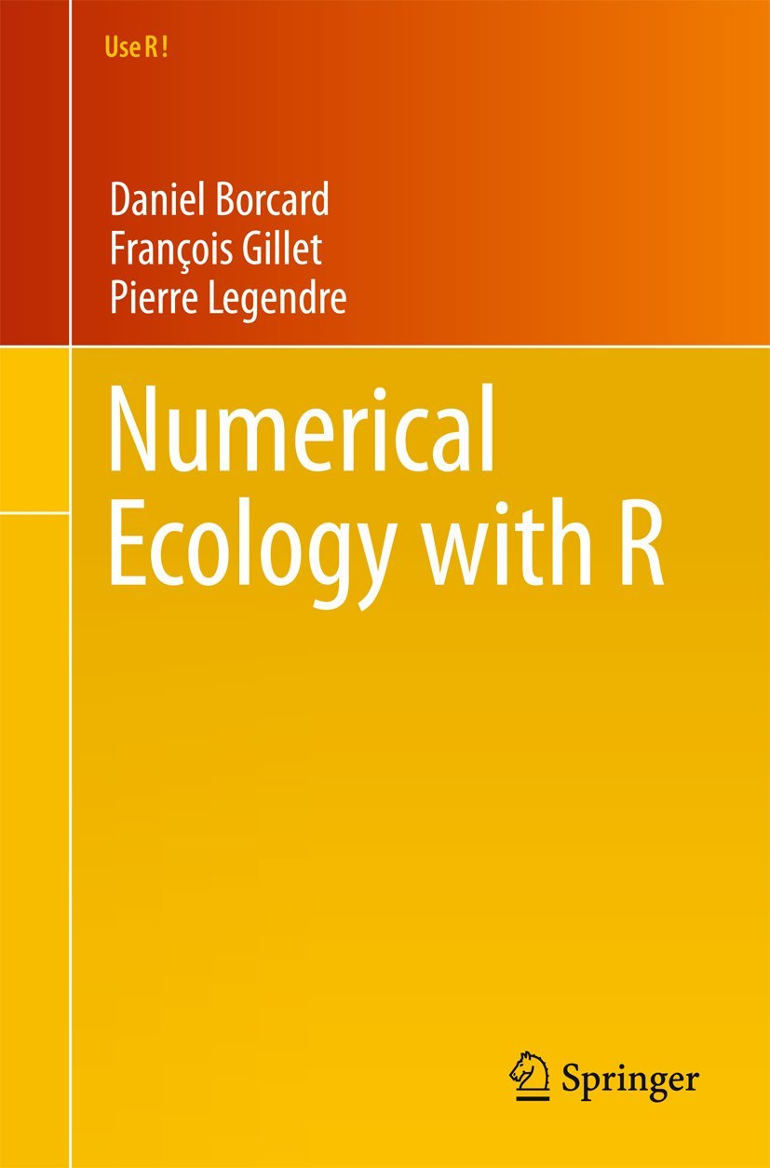

Pierre Legendre

Slide 32
Practice in R
Use the mite dataset (70 sites, 35 species) from R package ‘vegan’
Calculate beta-diversity
Variation partitioning of beta-diversity between sites using partial regression
Variation partitioning of community compositions data using partial RDA

